Slide 1

Ayurvedic Intelligence: Revolutionizing Ayurveda with AI
Presented by: Sandesh Dharel
Ashish Agrawal
Dipesh Shrestha
Kiran Pokharel

Slide 2
INTRODUCTION
Ayurveda, a traditional system of medicine, has been a cornerstone of Nepalese healthcare.
This project leverages AI to digitize, analyze, and enhance Ayurvedic practices for a modern audience.

Slide 3
PROBLEM STATEMENT
- Limited accessibility to traditional herbal knowledge.
- Lack of personalized health recommendations.
- Minimal integration between traditional and modern technologies.

Slide 4
PROJECT OBJECTIVES
To provide people with insights into Ayurvedic medicinal plants.
1
To leverage AI to offer personalized recommendations for health.
2
To provide yoga, diet, and meditation plans, making holistic Ayurvedic care easily accessible.
3

Slide 5
PROJECT SCOPE
Implement user friendly interface for easy navigation and interaction
3
Integrate NLP for personalized Ayurvedic remedies based on user symptoms
2
Develop an AI powered system for herb identification using image recognition
1

Slide 6
RELATED WORKS

Slide 7

AI-Well
Features:
Health assessments based on Ayurvedic doshas.
Integration with wearable devices for monitoring.
Drawbacks:
Limited regional availability.
Privacy concerns with data usage.

Slide 8

Patanjali
Features:
Affordable pricing and strong distribution.
Wide range of Ayurvedic products.
Drawbacks:
Quality control issues.
Limited international availability.

Slide 9

Ayucare
Features:
Online Ayurvedic consultations.
Personalized health plans.
Drawbacks:
Dependent on internet connectivity.
Generic advice without deep personalization.

Slide 10

Nepal Ayurveda
Features:
Provides Ayurvedic consultations and herbal remedies.
Focuses on traditional Nepalese healing practices
Drawbacks:
Limited technological features
Availability of authentic products can be challenging

Slide 11
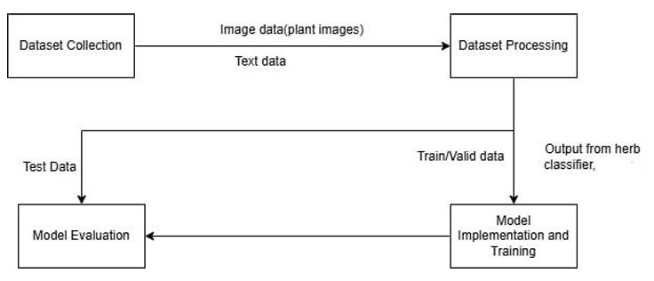
Nepal Ayurveda
Model Design For Image Classification

Slide 12
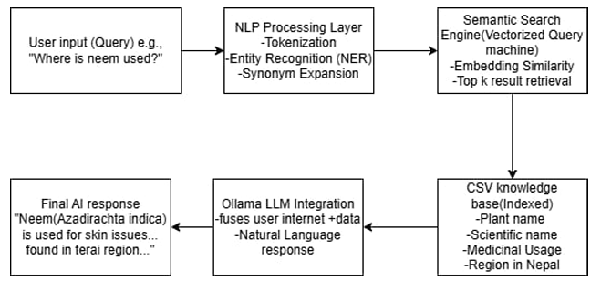
Nepal Ayurveda
Model Design of Chatbot

Slide 13
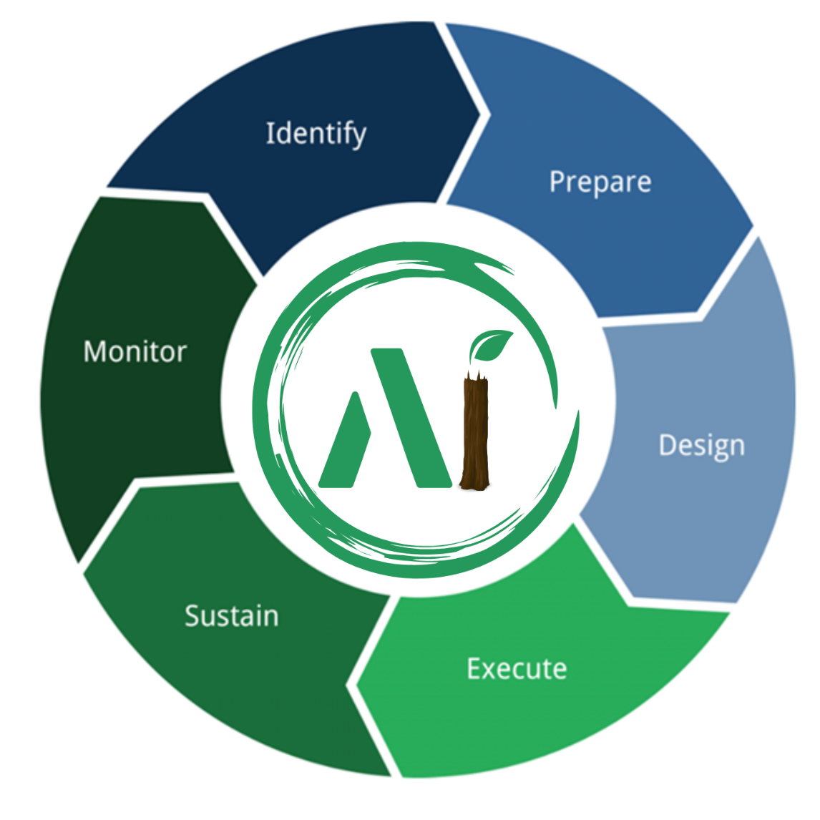
METHODOLOGY
FIGURE: AGILE METHODOLOGY

Slide 14
TECHNOLOGY STACK
Jupiter Notebook with Google Colab: It’s seamless integration with Google Drive allowed us to store and retrieve both the dataset and trained model efficiently.
PyTorch provided ResNet-18, a deep convolutional neural network pretrained on ImageNet, for image classification.
Used PIL to open and convert new input images processsable format.
With torchvision library, transforms was used to apply preprocessing like resizing and horizontal flipping.
The learning rate was set to 0.001, providing a small step size during optimization to prevent overshooting. We used a batch size of 32, which offers a good balance between training performance and memory usage. The model was trained for 20 epochs, meaning it completed 20 full passes over the entire training dataset.
LR=0.001 BATCH_SIZE=32 EPOCH=20

Slide 15
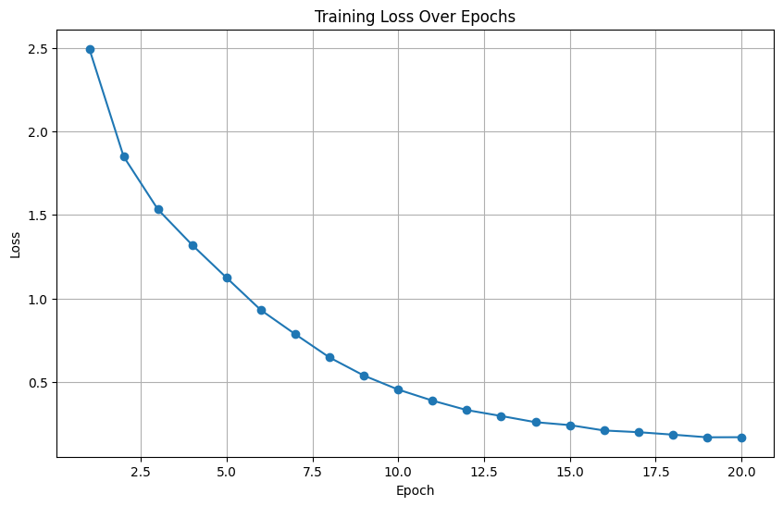
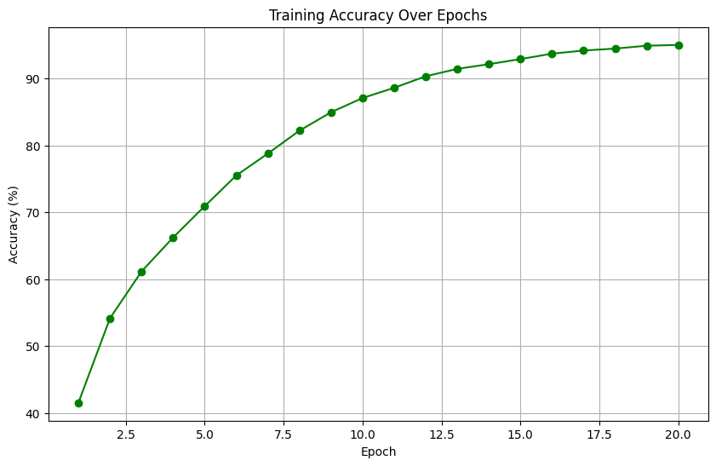
Training Loss and Accuracy over Epochs
Loss dropping below 0.1 by the 20th epoch
Accuracy improving from about 41% to 94%

Slide 16
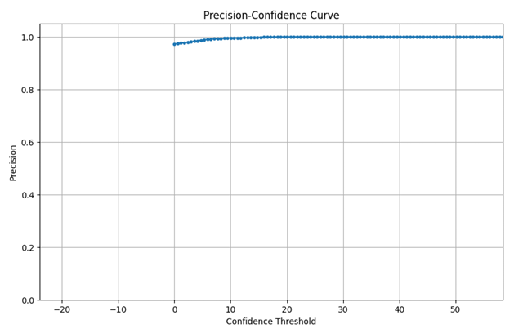
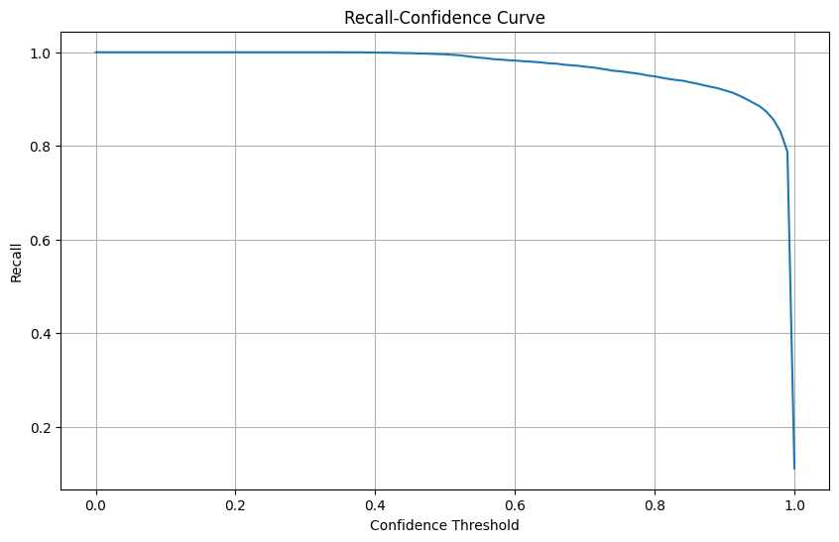
More Model Evaluation
The threshold crosses 50 so the predictions are nearly all correct. This indicates that higher confidence scores correspond to more correct predictions.
The precision-recall curve visualizes that the model captures a high number of true positives (high recall).

Slide 17
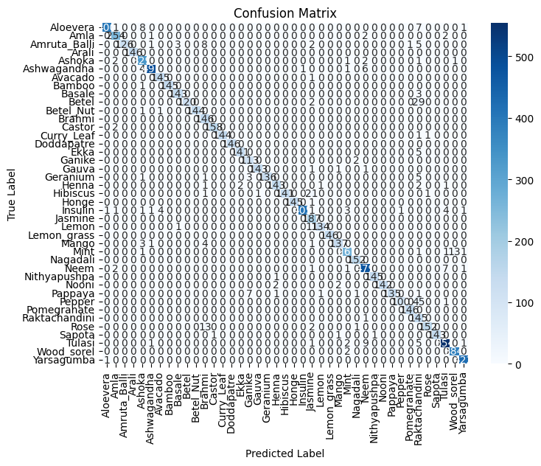
Confusion Matrix
Classifier has high accuracy overall, with most herbs correctly predicted. Misclassifications were minimal and mostly between visually similar plants.
We did best to improve with more data and fine-tuning.

Slide 18
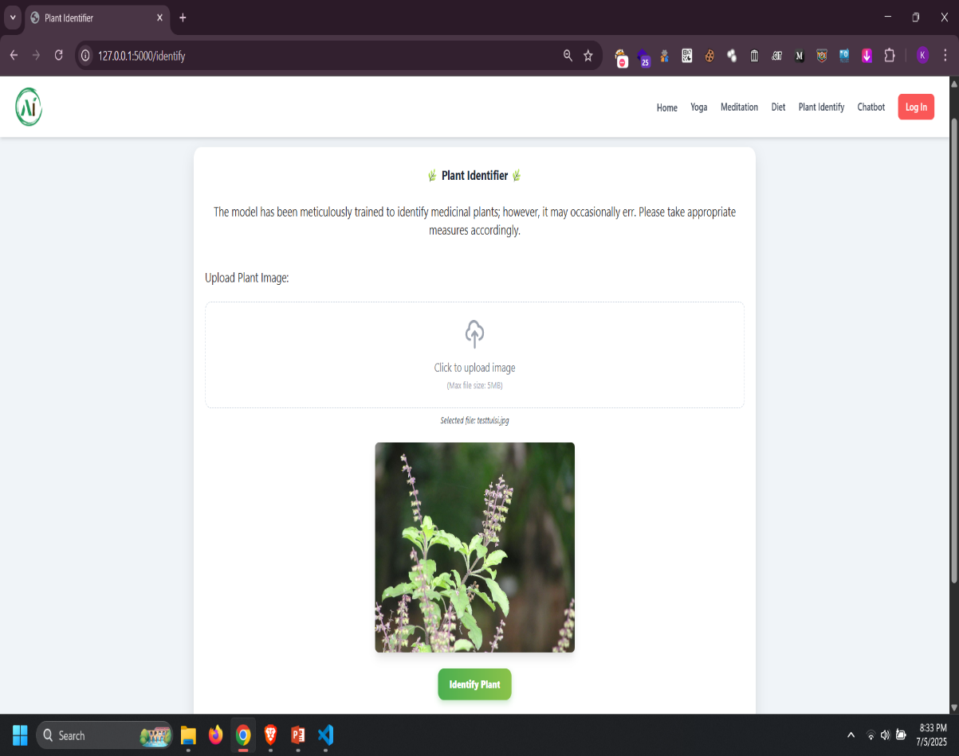
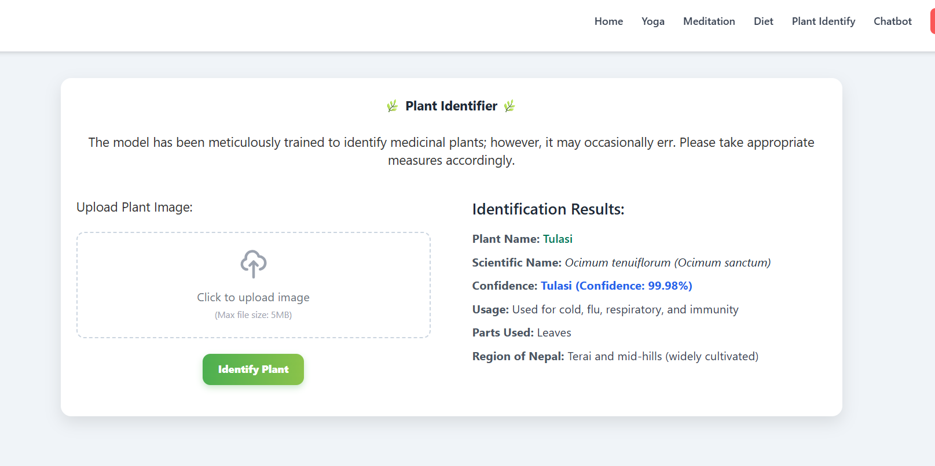
Result & Discussion
Input
Output

Slide 19
CHALLENGES & SOLUTIONS
Data-Related Issues: Unbalanced classes, noisy images
Model-Related Issues: Underfitting/Overfitting
Training Issues: Tuning Hyperparameters
Data Cleaning and Augmentation
Model Selection and Regularization
Hyperparameter Tuning and Optimized Training
Iterative Testing and Feedback

Slide 20
COMPLETED & FUTURE ENHANCEMENT
Android App for plant recognition
Real time video based plant recognition
Voice Based Symptom Input and Conversation
Advanced Herb Image Classifier: Improved the image classifier for higher accuracy.
Advanced Chatbot: Enhanced the Chatbot to handle more complex queries.

Slide 21
THANK YOU!

